Slide 1

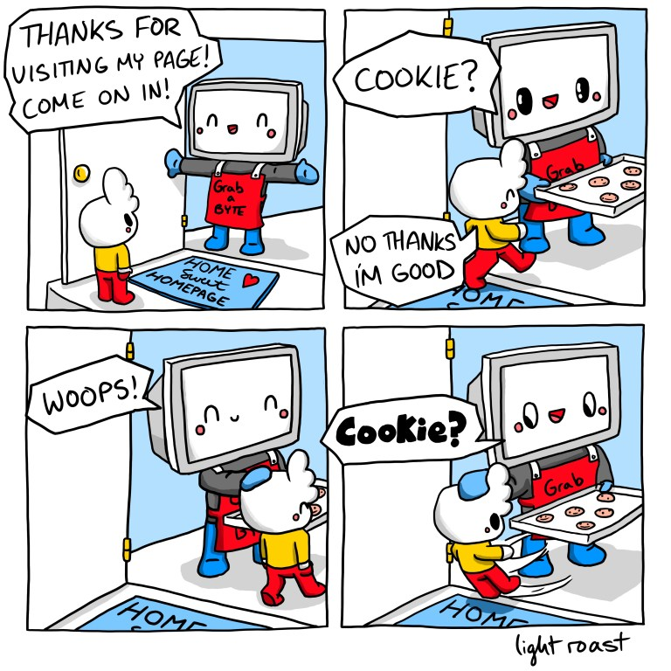
Cookies and CSRF
Lecture 10

Slide 2
Last Time: URLs
URL: A string that uniquely identifies one piece of data on the web
Parts of a URL:
Protocol: Defines which Internet protocol to use to retrieve the data (e.g. HTTP or HTTPS)
Location: Defines which web server to contact
Can optionally contain a username or port
Path: Defines which file on the web server to fetch
Query (optional): Sends arguments in name-value pairs to the web server
Fragment (optional): Not sent to the web server, but used by the browser for processing
Special characters should be URL escaped

Slide 3
Last Time: HTTP
HTTP: A protocol used to request and retrieve data from a web server
HTTPS: A secure version of HTTP
HTTP is a request-response protocol
HTTP request
Method (GET or POST)
URL path and query parameters
Protocol
Data (only for POST requests)
HTTP response
Protocol
Status code: A number indicating what happened with the request
Headers: Metadata about the response
Data
Notes:
HTTP is the set of rules that let’s us communicate over the web. HTTP is a one request, one response model (so a request-response protocol). We briefly described HTTPS, which is a more secure version of HTTP, and we’ll dive deeper into that in our networking unit.

Slide 4
Last Time: Parts of a Webpage
HTML: A markup language to create structured documents
Create a link
Create a form
Embed an image
Embed another webpage (iframe or frame)
CSS: A style sheet language for defining the appearance of webpages
As powerful as JavaScript if used maliciously!
JavaScript: A programming language for running code in the web browser
JavaScript code runs in the web browser
Modify any part of the webpage (e.g. HTML or CSS)
Create pop-up messages
Make HTTP requests
Notes:
Javascript is browser-side code. The code can be sent from the server and then is executed browser side on your computer!

Slide 5
Today: Mysteries
How is it that if I can open Gmail today and read my email, even though I didn't log in today? How does it remember me?
How is it that if I'm logged out from Google, and then I log into my Google account in one browser window, my Google docs in other browser windows update to show me as logged in, even though I didn't log in in those windows?
Notes:
We’re going to start today by going through some critical features of the web: cookies! I hope you’re enjoying your cookie in person and if you’re online or on the zoom recording, please enjoy this image of Evanbot eating a cookie (drawn by one of our fabulous artists Ashley Zhang).
Then, we’re going to dive into session authentication, Cross-Site Request Forgery (CSRF), and CSRF Defenses in the back half of the lecture.
Session authentication is going to look fairly similar to cookies, because it’s really an application of cookies. And then CSRF is an attack on cookies that we’ll dive into.

Slide 6

Today: Cookies and CSRF
Cookies
Parts of a cookie
Cookie Policy
Setting cookies
Sending cookies
Session Authentication
Cross-Site Request Forgery (CSRF)
CSRF Defenses
Notes:
We’re going to start today by going through some critical features of the web: cookies! I hope you’re enjoying your cookie in person and if you’re online or on the zoom recording, please enjoy this image of Evanbot eating a cookie (drawn by one of our fabulous artists Ashley Zhang).
Then, we’re going to dive into session authentication, Cross-Site Request Forgery (CSRF), and CSRF Defenses in the back half of the lecture.
Session authentication is going to look fairly similar to cookies, because it’s really an application of cookies. And then CSRF is an attack on cookies that we’ll dive into.

Slide 7
Cookies

Slide 8
Customizing HTTP Responses
An excellent read: https://developer.mozilla.org/en-US/docs/Web/HTTP/Guides/Cookies
HTTP is a request-response protocol
The web server processes each request independently of other requests
What if we want our responses to be customized?
Example: If I enable dark mode on a website, I want future responses from the website to be in dark mode
Example: If I log in to a website, I want future responses from the website to be related to my account
Notes:
Request-response model -> no recollection of previous HTTP requests/responses, no impact on future requests
Maybe this is fine: request two different movies, they don’t depend
However, we want to remember state across different requests–this is where cookies come into play!

Slide 9
Cookies: Definition
Cookie: a piece of data used to maintain state across multiple requests
This data is stored and remembered by the browser, and sent to server when needed
Creating cookies
The server can create a cookie by including a Set-Cookie header in its response
JavaScript running in the browser can create a cookie
Storing cookies
Cookies are stored by the web browser (not the web server)
The browser’s cookie storage is sometimes called a cookie jar
Sending cookies
The browser automatically attaches relevant cookies to every request
The server uses received cookies to customize responses and connect related requests
Notes:
HTTP doesn’t remember what requests were previously made
Use cookies to link together past, present, and future requests/responses
Cookies hold information like “this person logged in at 12:50pm, if they stay on this machine, let them stay logged in”, or “this person selected dark mode, please don’t sear their eyeballs off with light mode”.
Well, when we’re defining what this cookie is, we need to figure out three things: how do we create cookies, store them, and send them?
Create cookies
Send based on request (one response per request). Sends HTML + in the header “here’s a cookie, keep it safe” -> Set-Cookie header
Dark mode button -> Javascript runs when button is clicked
Manually create your own cookies
On Chrome: inspect page -> applications -> cookies

Slide 10
Parts of a Cookie: Name and Value
https://developer.mozilla.org/en-US/docs/Web/HTTP/Reference/Headers/Set-Cookie
The actual data in the cookie is stored as a name-value pair
Name | Theme
Value | Dark
Domain | toon.cs161.org
Path | /xorcist
Secure | True
HttpOnly | False
Expires | 11 Jul 2024 20:00:00
(other fields omitted)
Notes:
10 min - 12:50
Name-value pair for communication (like a hashmap or python dictionary) -> give examples

Slide 11
Parts of a Cookie: Domain and Path
The domain attribute and path attribute define which requests the browser should attach this cookie for
The domain attribute usually looks like the domain in a URL
The path attribute usually looks like a path in a URL
Avoid leaking cookies across unrelated parts of the same domain.
Name | Theme
Value | Dark
Domain | toon.cs161.org
Path | /xorcist
Secure | True
HttpOnly | False
Expires | 11 Jul 2024 20:00:00
(other fields omitted)
Notes:
Besides the name and value, we also need to know what websites to associate this cookie with
Would dark theme relate to every website, cs161.org?
Scopes the cookie
Technically not a URL, just decides what websites are relevant
Cookie jar analogy

Slide 12
Parts of a Cookie: Secure and HttpOnly
The Secure attribute and HttpOnly attribute restrict the cookie for security purposes
If the Secure attribute is True, then the browser only sends the cookie if the request is made over HTTPS (and doesn't send the cookie with HTTP requests)
If the HttpOnly attribute is True, then JavaScript in the browser is not allowed to access the cookie
Name | Theme
Value | Dark
Domain | toon.cs161.org
Path | /xorcist
Secure | True
HttpOnly | False
Expires | 11 Jul 2024 20:00:00
(other fields omitted)
Notes:
Main security attributes
HTTPOnly true: Javascript cannot see the cookies or modify
Cookie jar analogy -> filter through

Slide 13
Parts of a Cookie: Expires
The Expires attribute defines when the cookie is no longer valid
The expires attribute is usually a timestamp
If the timestamp is in the past, then the cookie has expired, and the browser deletes it from the cookie jar
Name | Theme
Value | Dark
Domain | toon.cs161.org
Path | /xorcist
Secure | True
HttpOnly | False
Expires | 11 Jul 2024 20:00:00
(other fields omitted)
Notes:
Like an expiration date on certificates!

Slide 14
Cookie Policy

Slide 15
Cookies: Issues
Recall:
The server can create a cookie by including a Set-Cookie header in its response
The browser automatically attaches relevant cookies in every request
Security issues:
A server should not be able to set cookies for unrelated websites
Example: evil.com should not be able to set a cookie that gets sent to google.com
Cookies shouldn’t be sent to the wrong websites
Example: A cookie used for authenticating a user to Google should not be sent to evil.com
We’ll see how cookies are used for logins later
Notes:
“Relevant” is vague -> we’ll formally define it in a bit
evil.com setting cookie for cs161.org dark mode -> feels like we’re breaking the same origin policy
evil.com should not be able to affect cs161.org
Cookies with bank account information/secret login shouldn’t be sent to the wrong place
Should only be attached to bank account requests, etc.

Slide 16
Cookie Policy
Cookie policy: A set of rules enforced by the browser
When the browser receives a cookie from a server, should the cookie be accepted?
When the browser makes a request to a server, should the cookie be attached?
Cookie policy is (confusingly) different from the same-origin policy
Notes:
Enforced by browser because cookies are stored browser-side
Specific to cookies and how they’re sent/stored, not the same as SOP
Both relate to ensuring some sort of separation between different websites, but different purposes

Slide 17
Domain Hierarchy
Recall: Domains
Located after the double slashes, but before the next single slash
Written as several phrases separated by dots
Domains can be sorted into a hierarchy
The hierarchy is separated by dots
. (root)
.edu
.org
.com
berkeley.edu
mit.edu
cs161.org
edstem.org
google.com
Notes:
15 min - 12:55
Organization of domains
What does it mean for domains to be related? -> trying to make “relevant” less vague
Split on the dots
berkeley.edu and mit.edu both belong to the .edu family of domains
.root is the top of the hierarchy -> set of all possible domains
Will reappear in DNS
More “specific” domain -> berkeley.edu, less “specific -> .edu

Slide 18
Domain Hierarchy
. (root)
.edu is a top-level domain (TLD), because it is directly below the root of the tree.
.edu
berkeley.edu
eecs.berkeley.edu is a subdomain of berkeley.edu.
eecs.berkeley.edu
Notes:
More vocab terms!
Single dot followed by string of letters -> TLD
su24.cs161.org is a subdomain of cs161.org

Slide 19
Cookie Policy: Setting Cookies
When the browser receives a cookie from a server, should the cookie be accepted?
Server with domain X can set a cookie whose domain attribute is Y if
(1) The domain attribute is a domain suffix of the server’s domain
X ends in Y
X is below or equal to Y on the hierarchy
X is more specific or equal to Y
... and, (2) the domain attribute Y is not a top-level domain (TLD)
No restrictions for the Path attribute (the browser will accept any value)
Examples:
mail.google.com can set cookies for Domain=mail.google.com or Domain=google.com
google.com can set cookies for Domain=google.com
google.com cannot set cookies for Domain=com, because com is a top-level domain
Notes:
20 min - 1:00
Do I accept cookie into cookie jar?
Don’t want evil.com to impact other sites like bank logins
Domain attribute Y = from cookie, domain X = who is sending the response
3 examples kind of mean the same thing
Give example of all three with X=eecs.berkeley.edu & Y=berkeley.edu
Getting a response from eecs.berkeley.edu setting a cookie w domain attribute berkeley.edu
Reuse evil.com & google.com example -> we’ve thwarted this!
Pretty mechanical -> makes “relevant” less vague by using domain hierarchy!
Why not TLD? If set for .com -> cookie is set for every .com site in the world -> that’s too much power!
evil.com should not be able to assign cookies for all the .coms
Pause Qs

Slide 20
Cookie Policy: Sending Cookies
When the browser makes a request to a server, should the cookie be attached?
The browser sends the cookie if both of these are true:
The domain attribute is a domain suffix of the server’s domain
The path attribute is a prefix of the server’s path
Notes:
25 min - 1:05
Now we know how to set -> let’s figure out when to send cookies!
When to fish out of the cookie jar (filtering out cookies)
Much shorter policy!
All cookies are stored together in cookie jar -> not separated by domain/path
We’re finally defining “relevant” -> these two rules
This is hard to understand using words alone -> next slide goes through an example!

Slide 21
Intuition: Domain attributes
If the domain attribute is set to google.com, think of this as representing google.com or *.google.com or *.*.google.com or ...
A server can only set a cookie if the server matches the cookie's domain attribute
A cookie is only sent to a server if the server matches the domain attribute
Notes:
25 min - 1:05
Now we know how to set -> let’s figure out when to send cookies!
When to fish out of the cookie jar (filtering out cookies)
Much shorter policy!
All cookies are stored together in cookie jar -> not separated by domain/path
We’re finally defining “relevant” -> these two rules
This is hard to understand using words alone -> next slide goes through an example!

Slide 22
Cookie Policy: Sending Cookies
(server URL)
https://toon.cs161.org/cryptoverse/oneshots/subway.html
cs161.org/cryptoverse
(cookie domain)
(cookie path)
Quick method to check cookie sending:
Right-align the domains. The cookie domain should be a suffix of the server URL.
Notes:
Walkthrough parts of a URL
Comparing domains

Slide 23
Cookie Policy: Sending Cookies
(server URL)
https://toon.cs161.org/cryptoverse/oneshots/subway.html
cs161.org/cryptoverse
(cookie domain)
(cookie path)
Quick method to check cookie sending:
Right-align the domains. The cookie domain should be a suffix of the server URL.
Left-align the paths. The cookie domain should be a prefix of the server path.
Notes:
Cookie path

Slide 24
Cookie Policy: Sending Cookies
(server URL)
https://toon.cs161.org/cryptoverse/oneshots/subway.html
cs161.org/cryptoverse
(cookie domain)
(cookie path)
Quick method to check cookie sending: Concatenate the cookie domain and path. Line it up below the requested URL at the first single slash.
If the domains and paths all match, then the cookie is sent.
Notes:
Combining into one step
Everything in the cookie has to be in the server URL (perfect match)

Slide 25
Cookie Policy: Sending Cookies
(server URL)
https://toon.cs161.org/cryptoverse/oneshots/subway.html
cs161.org/xorcist
(cookie domain)
(cookie path)
Quick method to check cookie sending: Concatenate the cookie domain and path. Line it up below the requested URL at the first single slash.
If the domain or path doesn’t match, then the cookie is not sent.
Notes:
Mismatch on the path
This cookie is not “relevant” -> we’ve defined this now!

Slide 26
Cookie Policy: Sending Cookies
(server URL)
https://su24.cs161.org/proj2/story
www.cs161.org/proj2
(cookie domain)
(cookie path)
Will a cookie with this domain and path be sent to this server?

Slide 27
Cookie Policy: Sending Cookies
(server URL)
https://su24.cs161.org/proj2/story
www.cs161.org/proj2
(cookie domain)
(cookie path)
Will a cookie with this domain and path be sent to this server?
No! The domain does not match!
Notes:
su24.cs161.org is not more specific or lower on the hierarchy compared to www.cs161.org (they’re on the same level)!

Slide 28
Attacks on Cookies
Notes:
30 min - 1:20

Slide 29
Cookie Ambiguity
If two cookies should both be sent to a page with the same name, they are sent in an undefined order!
Consider two cookies:
name=value1; Domain=bank.com; Path=/
name=value2; Domain=bank.com; Path=/page
The browser would send both cookies to bank.com/page in an undefined order!
The server doesn’t receive the Domain and Path attributes
The server might not be able to tell the cookies apart
Notes:
Surprise!
If we use two log-in cookies, there’s no guarantee that the correct one is chosen!
Research was done that in Google chat, if you made a separate login specifically for that, if you’re on your gmail page, you’d be logged into your email, but sometimes logged into a different user’s chat!
Chat window would be rendered as a malicious user, not you
They’ve fixed this, but undefined cookie order is still a problem today
How do you know which cookie is which? The names are the same…

Slide 30
Spectre Attack: Vulnerability
Original browser design: Chrome isolated each tab in its own Unix process
Security sandboxing: The operating system (OS) makes sure that one process cannot access other processes
Makes attacks harder: To compromise another tab, you have to exploit the browser code and escape the Unix sandbox
Usability: If one tab crashes, the rest of the browser won’t crash
Issues with this design
There are many scenarios where a program wants to protect data from other parts of the same program
Notable example: If one tab includes multiple origins (e.g. from an iframe embed), the browser must enforce same-origin policy: JavaScript from one origin cannot read cookies related to the other origin
Notes:
Covers 162 (processes) & 152 (speculative) material
Cannot read cookies of other domains
Previously, every tab was run in its own process -> each process was sandboxed
However, this is expensiveeee
Javascript in one origin cannot see another’s

Slide 31
Spectre Attack: Exploiting browser design
Spectre: An attack exploiting this browser design
The victim visits evil.com in a browser tab
evil.com opens an iframe with victim.com
Recall: JavaScript in evil.com should not be able to read any cookies from victim.com
evil.com and victim.com are now running in the same operating system process
No operating system sandboxing is active! The only memory protection is enforced by the JavaScript compiler
If we can break the JavaScript compiler, we can read memory from victim.com
Notes:
Javascript cannot get any information about the iframe
Each tab runs its own OS process means evil.com and victim.com are sharing a process
Processes share memory so at the OS level, these two can actually talk to each other
The only thing stopping them is the JavaScript compiler, so if that breaks… no more isolation

Slide 32
Spectre Attack: Exploiting the processor
Quick review: Modern processors
Designed to be very fast: High instructions per cycle (IPC)
Uses aggressive behavior to achieve high IPC
Aggressive caching
Branch prediction: Guess the outcome of a branch and start executing that branch before the outcome is known
Speculative execution: Execute some code if the processor thinks it’ll be executed later
Note: Predictions are not always correct
Spectre: Exploits a hardware side-channel attack
Use a side channel (e.g. timing, cache state) to detect the results of failed speculative execution
Use a side channel to see what the input to the speculative execution was
Idea: Force speculative execution by forcing the processor to make wrong predictions
Idea: Read the side channel to see the results of the speculative execution
Notes:
Modern processors use branch prediction and speculative execution
You don’t want to wait–it’s more optimized to guess and start executing to not waste clock cycles (remember 61c!) -> really helps with performance!
However, predictions aren’t always correct -> usually the work would be done, but not fully committed (registers wouldn’t be written to)
“If you don’t actually write to a register, the instruction didn’t actually happen”
Spectre took advantage of this hardware side-channel
Use side channels & speculative execution
Force program to guess wrong
Normally not a problem because computations wouldn’t be written to the registers, however, if the computation includes memory load, it’s loaded into the cache
This leaks information & disrupted the cache!

Slide 33
Spectre Attack: Exploiting the processor
Using the side-channel to break the JavaScript compiler’s memory isolation
Recall: evil.com has loaded an iframe with victim.com
evil.com executes a repeated loop with legitimate instructions
The branch predictor is trained to think this loop will keep going (it will keep guessing the while condition is true)
On the last run of the loop, the processor incorrectly guesses it will keep going and starts running the loop one more time (speculative execution)
In the speculative run of the loop, do computation on illegal memory (e.g. victim.com’s cookies)
Use the side-channel to leak some information about the illegal memory being read
Repeat this process to leak all the desired information
i = 0
while i <= 1000:
if i <= 1000:
[legal things]
else:
[illegal things]
i += 1
Speculative execution: The else case never runs, but the predictor will try to execute it after the last run of the loop
Notes:
This broke Javascript’s memory isolation!
Tab in one process
Evil illegal thing shouldn’t technically ever run, but predictor will guess that it needs to execute and thus runs the illegal computation (maybe looking up the victim’s cookies)
When it realizes that it didn’t actually need to run the while loop again, it will undo everything, but data would’ve already been pulled into the cache

Slide 34
Spectre Attack: Defenses
Chrome and Firefox now run each origin, not tab, in its own process
Known as "Site Isolation"
Recall: The operating system (OS) makes sure that one process cannot access other processes
Security: Spectre attack is defeated
When evil.com loads an iframe with victim.com, the two frames are run in different processes
Speculative execution no longer works: the OS prevents the evil.com process from accessing memory of the victim.com process
The attack now requires breaking the OS isolation (much harder)
Cost: Processes are expensive
Lots of memory overhead
Switching between processes is expensive: optimizations (e.g. caches) must be wiped
Notes:
Now to run Spectre, you’d have to be able to access memory from a different process -> breaks OS isolation
This is the reason why your browser eats up so much memory -> site isolation means we run each origin, not tab, in its own process
Remember, images run with the origin of the site they came from
If a site webpage loads four images from different sites -> thats 5 different processes! That’s supper expensive!!!
Lots of expensive context switching

Slide 35
Spectre Attack: Takeaways
Takeaway: Enforcing isolation between websites (same-origin policy, cookie policy) requires the browser to be securely designed. Getting this right can be very tricky!
Takeaway: The web was not designed in security in mind. Many defenses (e.g. same-origin policy) were added afterwards, leading to awkward design and expensive performance costs

Slide 36
Session Authentication
Notes:
40 min - 1:20
That’s all for our base knowledge on cookies!
(Are there any cookies remaining?)
We now know how to make cookies for dark mode and requests – here’s another common use case for cookies!

Slide 37
Session Authentication
Session: A sequence of requests and responses associated with the same authenticated user
Example: When you check all your unread emails, you make many requests to Gmail. The Gmail server needs a way to know all these requests are from you
When the session is over (you log out, or the session expires), future requests are not associated with you
Naïve solution: Type your username and password before each request
Problem: Very inconvenient for the user!
Better solution: Is there a way the browser can automatically send some information in a request for us?
Yes: Cookies!
Notes:
Without cookies, you’d need to type out username/password for each request :(
We like web cookies (almost as much as chocolate chip cookies)
Remember, vanilla HTML requests/responses do not remember past/future requests/responses
Cookies unlock power so we can get sessions!
Can stay logged in for a certain amount of time as long as something is the same -> that something is a cookie that will define a session

Slide 38
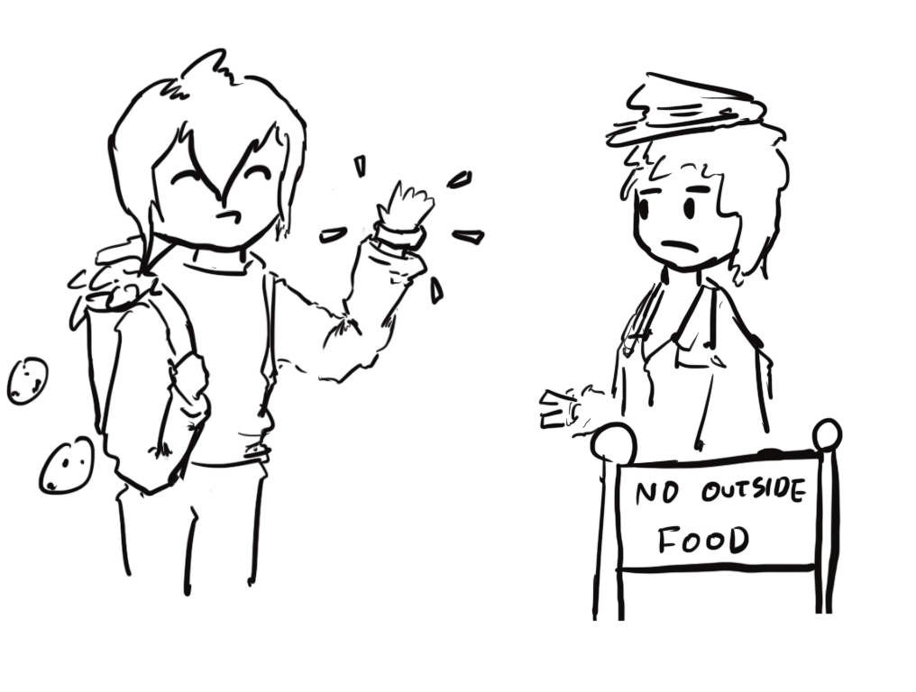
Session Authentication: Intuition
Imagine you’re attending a concert
The first time you enter the venue:
Present your ticket and ID
The doorperson checks your ticket and ID
If they’re valid, you receive a wristband
If you leave and want to re-enter later
Just show your wristband!
No need to present your ticket and ID again
Notes:
Ticket + ID = username + password -> only need it once
Would be horrible for bouncer to need to check all re-entries as well
Only nit: wristbands should be unique per person

Slide 39
Session Tokens
Session token: A secret value used to associate requests with an authenticated user
The first time you visit the website:
Present your username and password
If they’re valid, you receive a session token
The server associates you with the session token
When you make future requests to the website:
Attach the session token in your request
The server checks the session token to figure out that the request is from you
No need to re-enter your username and password!
Notes:
Session token = wristband
Present username/ticket, password/id -> get session token/wristband
Server sends a session token
We have to remember the session token -> cookies are stored browser-side.
Servers as well -> some sort of database (for checksum).
Why not in URL? -> people share URLs!

Slide 40
Session Tokens with Cookies
Session tokens can be implemented with cookies
Cookies can be used to save any state across requests (e.g., dark mode)
Session tokens are just one (common) way to use cookies
The first time you visit a website:
Make a request with your username and password
If they’re valid, the server sends you a cookie with the session token
The server associates you with the session token
When you make future requests to the website:
The browser attaches the session token cookie in your request
The server checks the session token to figure out that the request is from you
No need to re-enter your username and password!
When you log out (or when the session times out):
The browser and server delete the session token
Notes:
Simplest implementation of session tokens is with cookies
This is not the only use of cookies
Personalize content, track user interactions, save site settings, etc
Session token is high level idea, use cookies to implement
If I’m requesting unread emails, it will only send mine (v someone else) -> this is the differentiator
Can choose to log out or the session may time out (cookie expires)

Slide 41
The Basic Idea: Intuition (A Close Approximation)
Server sends the browser a cookie
The cookie is attached to every subsequent request to the same server that originally set the cookie
The cookie contains a random, unique value that identifies the user: e.g., sessionid=09c3ad..9f
The browser remembers the domain of the server that set the cookie, and sends this value along with every request to that domain
The server remembers the association sessionid=09c3ad..9f ⇄ userid=daw
This way, the server can associate each request to the user who is logged in
Notes:
10 min - 12:50
Name-value pair for communication (like a hashmap or python dictionary) -> give examples

Slide 42
Session Tokens: Security
If an attacker steals your session token, they can log in as you!
The attacker can make requests and attach your session token
The server will think the attacker’s requests come from you
Servers need to generate session tokens randomly and securely
Browsers need to make sure malicious websites cannot steal session tokens
Enforce isolation with cookie policy and same-origin policy
Browsers should not send session tokens to the wrong websites
Enforced by cookie policy
Notes:
Like a key from crypto -> this is the important thing to keep secret
Use a secure PRNG
Long and random, 256 bits for example -> remember we discussed that 2^80 is a reasonable threshold so 1/2^256 is pretty much inconceivable
Browser needs to enforce isolation
Cookie policy: don’t let evil.com see the session token
SOP: prevents other websites from accessing values
Only attach “relevant” cookies via cooke policy!

Slide 43
Session Token Cookie Attributes
What attributes should the server set for the session token?
Domain and Path: Set so that the cookie is only sent on requests that require authentication
Secure: Can set to True to so the cookie is only sent over secure HTTPS connections
HttpOnly: Can set to True so JavaScript can’t access session tokens
Expires: Set so that the cookie expires when the session times out
Name | token
Value | {random value}
Domain | mail.google.com
Path | /
Secure | True
HttpOnly | True
Expires | {15 minutes later}
(other fields omitted)
Notes:
We build out a cookie form!
Name: token, session_token, CalCentral uses calcentral_session, _jhSessionUser
Value: 256 bit -> inconceivable to guess
Domain & Path: really important! Messing up means malicious sites may be sent the session token!
Secure = false -> not sent, will be safe in cookie jar

Slide 44
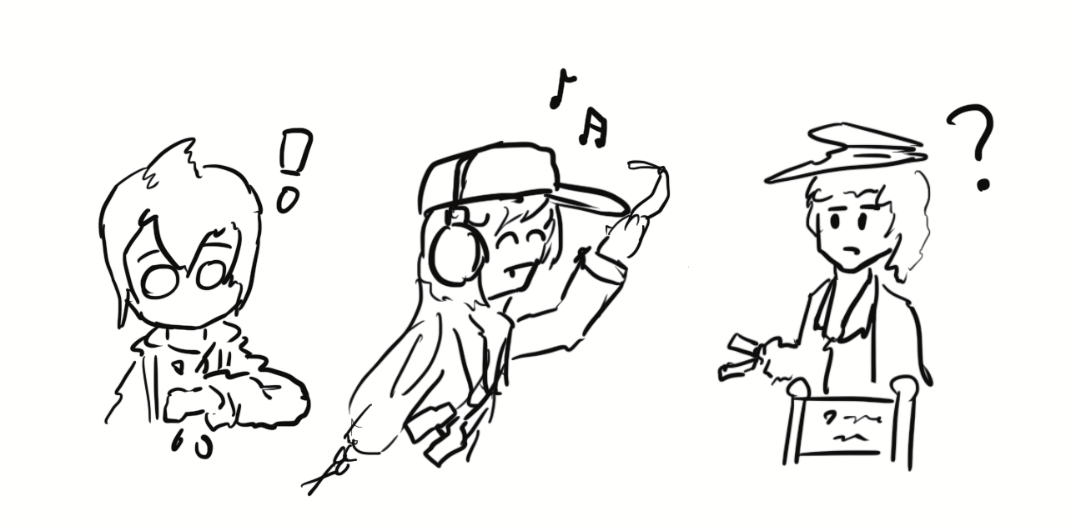
Cross-Site Request Forgery (CSRF)
Notes:
50 min - 1:30

Slide 45
Review: Cookies and Session Tokens
Session token cookies are used to associate a request with a user
The browser automatically attaches relevant cookies in every request

Slide 46
Cross-Site Request Forgery (CSRF)
Idea: What if the attacker tricks the victim into making an unintended request?
The victim’s browser will automatically attach relevant cookies
The server will think the request came from the victim!
Cross-site request forgery (CSRF or XSRF): An attack that exploits cookie-based authentication to perform an action as the victim
Notes:
What are relevant cookies?
Any where the domain attribute is a suffix of the server attribute + path attribute is a prefix of the server path
If attacker tricks me into making a request I did not intend to make, cookies will be attached (server doesn’t know they got tricked)
The exploit builds on the fact that browser automatically attaches relevant cookies.

Slide 47
Analogy: Passing Notes to My Banker
I have a bank account with a local bank, with $1000 in my checking account.
I can pay someone at any time by writing out a check (a note that is verified to come from me that says, e.g., "Please pay $50 to Alice from my account."), and giving this check to my bank
I'm at a party, and a stranger Genevieve confides to me that she has a crush on a guy there and convinces me to pass a romantic note to him without reading it.
Unbeknownst to me, the note actually says "Please pay $1000 to Genevieve from my account" ... and the guy is my banker. When he receives the note, he assumes I want to pay Genevieve and transfers money from my account to her.
The flaw: My banker assumed that if a request came from me, I must have authorized it.
Notes:
What are relevant cookies?
Any where the domain attribute is a suffix of the server attribute + path attribute is a prefix of the server path
If attacker tricks me into making a request I did not intend to make, cookies will be attached (server doesn’t know they got tricked)
The exploit builds on the fact that browser automatically attaches relevant cookies.

Slide 48
Steps of a CSRF Attack
User
Server
Attacker

Slide 49

Steps of a CSRF Attack
User authenticates to the server
User receives a cookie with a valid session token
User
1. Login
Server
Attacker
Notes:
Browser has valid session token
Server database has a checksum
If I send a request with this session token -> like a wristband

Slide 50
Steps of a CSRF Attack
User authenticates to the server
User receives a cookie with a valid session token
Attacker tricks the victim into making a malicious request to the server
User
1. Login
Server
2. Make this request
Attacker
Notes:
“Make this POST request”

Slide 51
Steps of a CSRF Attack
User authenticates to the server
User receives a cookie with a valid session token
Attacker tricks the victim into making a malicious request to the server
The server accepts the malicious request from the victim
Recall: The cookie is automatically attached in the request
User
1. Login
Server
2. Make this request
3. Malicious request
Attacker
Notes:
Server has no way of telling whether I intentionally made the request or if I was tricked!
Abuse of the fact that cookies are automatically attached
You don’t get to ask for cookies to be sent; it’s based on cookie policy

Slide 52
Steps of a CSRF Attack
User authenticates to the server
User receives a cookie with a valid session token
Attacker tricks the victim into making a malicious request to the server
The server accepts the malicious request from the victim
Recall: The cookie is automatically attached in the request
Notes:
Difficulty: how do we actually trick a user?

Slide 53
Executing a CSRF Attack
How might we trick the victim into making a GET request?
Strategy #1: Trick the victim into clicking a link
For example, send the victim an email with an enticing-looking link
The link can directly make a GET request: https://www.bank.com/transfer?amount=100&to=Mallory
The link can open an attacker’s website, which contains some JavaScript that makes the actual malicious request
Strategy #2: Put some HTML on a website the victim will visit
Example: The victim will visit a forum. Make a post with some HTML on the forum
HTML to automatically make a GET request to a URL: <img src="https://www.bank.com/transfer?amount=100&to=Mallory">
This HTML will probably return an error or a blank 1 pixel by 1 pixel image, but the GET request will still be sent...with the relevant cookies!
Notes:
Strategy #1: You’ve just won $1000 and a trip to the Bahamas. Click on this LINK to accept it!
Clicking on a link = browser opens = GET request (yikes)
Cookies automatically attached
Discussed also with clickjacking and phishing in the next lec
Strategy #2: This isn’t actually an image link, but the GET request is still made (yikes)
GET request is easier, just need user to click a link.

Slide 54
Executing a CSRF Attack
How might we trick the victim into making a POST request?
Example POST request: Submitting a form
Strategy #1: Trick the victim into clicking a link
Note: Clicking a link in your browser makes a GET request, not a POST request, so the link cannot directly make the malicious POST request
The link can open an attacker’s website, which contains some JavaScript that makes the actual malicious POST request
Strategy #2: Put some JavaScript on a website the victim will visit
Example: Pay for an advertisement on the website, and put JavaScript in the ad
Recall: JavaScript can make a POST request
Notes:
POST request are harder–clicking a link = GET request. POST submits other information.
POST request usually involves executing Javascript on the victim’s browser.

Slide 55
Top 25 Most Dangerous Software Weaknesses (2020)
Rank | ID | Name | Score
[1] | CWE-79 | Improper Neutralization of Input During Web Page Generation (’Cross-site Scripting’) | 46.82
[2] | CWE-787 | Out-of-bounds Write | 46.17
[3] | CWE-20 | Improper Input Validation | 33.47
[4] | CWE-125 | Out-of-bounds Read | 26.50
[5] | CWE-119 | Improper Restriction of Operations within the Bounds of a Memory Buffer | 23.73
[6] | CWE-89 | Improper Neutralization of Special Elements used in an SQL Command (’SQL Injection’) | 20.69
[7] | CWE-200 | Exposure of Sensitive Information to an Unauthorized Actor | 19.16
[8] | CWE-416 | Use After Free | 18.87
[9] | CWE-352 | Cross-Site Request Forgery (CSRF) | 17.29
[10] | CWE-78 | Improper Neutralization of Special Elements used in an OS Command (’OS Command Injection’) | 16.44
[11] | CWE-190 | Integer Overflow or Wraparound | 15.81
[12] | CWE-22 | Improper Limitation of a Pathname to a Restricted Directory (’Path Traversal’) | 13.67
[13] | CWE-476 | NULL Pointer Dereference | 8.35
[14] | CWE-287 | Improper Authentication | 8.17
[15] | CWE-434 | Unrestricted Upload of File with Dangerous Type | 7.38
[16] | CWE-732 | Incorrect Permission Assignment for Critical Resource | 6.95
[17] | CWE-94 | Improper Control of Generation of Code (’Code Injection’) | 6.53
Notes:
https://cwe.mitre.org/top25/archive/2020/2020_cwe_top25.html
Web attacks are going to check off a lot of these!

Slide 56
CSRF Example: Internet of Things (IoT)
IoT devices often use default passwords
Example login URL: http://10.1.1.1/login?user=admin&password=admin
The attacker tricks the victim into making a request to this link, which gives the victim a session token cookie
IoT devices often process commands with web requests
Example request URL: http://10.1.1.1/set-dns-server?server=8.8.8.8
These requests can perform actions that help the attacker mount other attacks
IoT devices don’t implement CSRF defenses
An attacker can publish an advertisement that makes these two requests
Any victim who opens a webpage with the advertisement will get their IoT device compromised!
Notes:
Nick calls it the "Internet of Shit"
We’re going to talk about DNS later, but if an attacker got access to the password to your router, they could change the DNS server for the router -> can intercept all traffic since attacker can lie and say that every server you want to communicate with is just them
Home gateway IP address is usually 10.1.1.1 or 10.0.1.1 -> only a couple different ones (we’ll talk about this later)
Most home gateways is username-admin password-admin
Now, victim is logged in -> they can reset the DNS server…
Sounds too easy, but it gets worse -> just publish an ad

Slide 57
CSRF Example: Malvertising
Short for malicious advertising
The attacker writes some JavaScript
The script opens a 1 pixel by 1 pixel frame (too small for human users to notice)
The frame opens a huge number of internal frames
Each frame launches possible CSRF attacks
The attacker pays for advertisements to put this JavaScript on legitimate websites
Takeaway: Advertisers might publish malicious scripts for you as long as you pay for it
Notes:
“If you’re going to crime, crime properly”???

Slide 58
CSRF Example: YouTube
2008: Attackers exploit a CSRF vulnerability on YouTube
By forcing the victim to make a request, the attacker could:
Make the victim share a video with their contacts
Make the victim subscribe to any channel
Add any videos to the user’s watchlist
Takeaway: With a CSRF attack, the attacker can force the victim to perform a wide variety of actions!
Notes:
You could literally do anything as the user
CSRF attack means you can do anything that the user can do if they were logged in -> super dangerous vulnerability!

Slide 59

CSRF Example: Facebook
 | Link
Facebook Hit by Cross-Site Request Forgery Attack
Sean Michael Kerner | August 21, 2009
Nevertheless, that Facebook accounts were compromised in the wild is noteworthy because the attack used a legitimate HTML tag to violate users’ privacy. According to Zilberman’s disclosure, the attack simply involved the malicious HTML image tag residing on any site, including any blog or forum that permits the use of image tags even in the comments section. "The attack elegantly ends with a valid image so the page renders normally, and the attacked user does not notice that anything peculiar has happened," Zilberman said.
Takeaway: The HTML image tag can be used to execute a CSRF attack
Notes:
http://www.internetnews.com/security/article.php/3835596/Facebook+Hit+by+CrossSite+Request+Forgery+Attack.htm
Facebook timeline = Instagram feed
Posts on user’s page the CSRF attack -> now your page contains that
Now… other people who view your page would also be hit with this attack

Slide 60
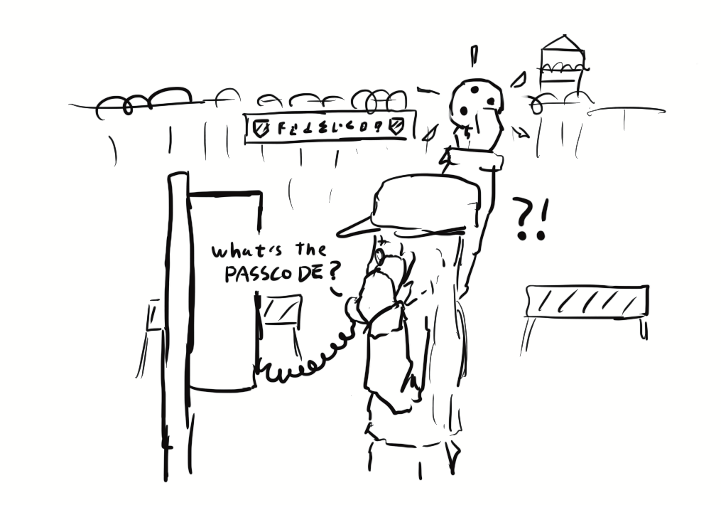
CSRF Defenses
Notes:
1 hr - 1:40
Trick user to click on a link -> make an actual request where server automatically attaches cookies
Thoughts on how we might defend against this?
Is this the responsibility of the web server or browser?
How does the browser know if you intend to make a request or not?
Might be more up to the server!

Slide 61
CSRF Defenses
CSRF defenses are implemented by the server (not the browser)
Defense: CSRF tokens
Defense: SameSite cookie attribute
Notes:
Main flaw: sent a request with the right cookie -> nothing to stop that cookie from going through
We want to add extra security beyond a session token

Slide 62
CSRF Tokens
Idea: Add a secret value in the request that the attacker doesn’t know
The server only accepts requests if it has a valid secret
Now, the attacker can’t create a malicious request without knowing the secret
CSRF token: A secret value provided by the server to the user. The server only accepts the request is this value is attached.
CSRF tokens cannot be sent to the server in a cookie!
The token must be sent somewhere else (e.g., a header, GET parameter, or POST content)
Notes:
Ask: Why not in a cookie?
Two secret values -> session token & CSRF token
Cookies are too automatic
Don’t put CSRF token in cookie or else it’ll just be sent alongside a session token!
Token is different every single time they serve the page to anyone
Why not valid for hundreds of requests?
Prevent replay attacks
Don’t want attacker to be able to use for future requests!
Not really a usability concern -> not something users usually have to input

Slide 63
CSRF Tokens: Usage
Example: HTML forms
Forms are vulnerable to CSRF
If the victim visits the attacker’s page, the attacker’s JavaScript can make a POST request with a filled-out form
CSRF tokens are a defense against this attack
Every time the user requests a form from the legitimate website, the server attaches a CSRF token as a hidden form field (in the HTML, but not visible to the user)
When the user submits the form, the request contains all form fields – including the CSRF token
The attacker’s JavaScript won’t be able to create a valid form, because they don’t know the CSRF token!
The attacker can try to fetch their own CSRF token, but it will only be valid for the attacker, not the victim
Notes:
Forms -> data sent as POST request
Without CSRF token, attacker could make victim visit a page + run Javascript to fill in a form (send Mallory $161) and submit via victim’s browser w/ user’s session token attached
With CSRF token
Extra field!
Malicious site doesn’t have access to CSRF token because of HTTP access control

Slide 64
CSRF Tokens: Usage
User
Server
token in form
1. Login
2. Get token
4. Make request
3. Make this request with attacker token
Attacker
The request in step 4 will fail, because the attacker doesn’t know the token!
Notes:
Burden is on user or user’s browser to attach that token.
Server side check!

Slide 65
Referer Header
Idea: In a CSRF attack, the victim usually makes the malicious request from a different website
Referer header: A header in an HTTP request that indicates which webpage made the request
“Referer” is a 30-year typo in the HTTP standard (supposed to be “Referrer”)!
Example: If you type your username and password into the Facebook homepage, the Referer header for that request is https://www.facebook.com
Example: If an img HTML tag on a forum forces your browser to make a request, the Referer header for that request is the forum’s URL
Example: If JavaScript on an attacker’s website forces your browser to make a request, the Referer header for that request is the attacker’s URL
Notes:
HTTP request usually involves metadata -> include referer header
Metadata can be stuff like “this request was made over Chrome” or “this request was made over HTTP 1.0”
Referer header: what webpage was I on when this request was made?
“This request came from evil.com” -> proceed? uh , definitely not.

Slide 66
Referer Header
Checking the Referer header
Allow same-site requests: The Referer header matches an expected URL
Example: For a login request, expect it to come from https://bank.com/login
Disallow cross-site requests: The Referer header does not match an expected URL
If the server sees a cross-site request, reject it
Notes:
Server can use referer header to check if user was tricked or actually made the request.
Now our cross-site request forgeries will be rejected.
It’s the server’s job to use the referer header
Seems like this is great right… but

Slide 67
Referer Header: Issues
The Referer header may leak private information
Example: If you made the request on a top-secret website, the Referer header might show you visited http://intranet.corp.apple.com/projects/iphone/competitors.html
Example: If you make a request to an advertiser, the Referer header gives the advertiser information about how you saw the ad
The Referer header might be removed before the request reaches the server
Example: Your company firewall removes the header before sending the request
Example: The browser removes the header because of your privacy settings
The Referer header is optional. What if the request leaves the header blank?
Allow requests without a header?
Less secure: CSRF attacks might be possible
Deny requests without a header?
Less usable: Legitimate requests might be denied
Need to consider fail-safe defaults: No clear answer
Notes:
It’s optional :’))
Why optional?
It leaks info
Then, we’d strip it
Fail-safe defaults: tradeoff on security & usability

Slide 68
SameSite Cookie Attribute
Idea: Implement a flag on a cookie that makes it unexploitable by CSRF attacks
This flag must specify that cross-site requests will not contain the cookie
SameSite=Strict flag: An attribute of a cookie that specifies it should be sent only when the domain of the cookie exactly matches the domain of the origin of the webpage that triggered the request
Example: If https://evil.com/ causes your browser to make a request to https://bank.com/transfer?to=mallory, cookies for bank.com will not be sent if SameSite=Strict, because the origin domain (evil.com) and cookie domain (bank.com) are different
Issue: Not yet implemented on some less-common browsers
Notes:
Another cookie attribute (like HTTPOnly or Secure)
Kind of like a referrer header
When I pick through cookie jar to figure out which cookies to send to server, check not only domain/path, but also samesite flag
Make sure the domain matches the domain attribute
Differs from domain check in cookie sending policy
Most modern browsers have the samesite cookie attribute

Slide 69
Cookies: Summary
Cookie: a piece of data used to maintain state across multiple requests
Set by the browser or server
Stored by the browser
Attributes: Name, value, domain, path, secure, HttpOnly, expires
Cookie policy
Server with domain X can set a cookie with domain attribute Y if the domain attribute is a domain suffix of the server’s domain, and the domain attribute Y is not a top-level domain (TLD)
The browser attaches a cookie on a request if the domain attribute is a domain suffix of the server’s domain, and the path attribute is a prefix of the server’s path

Slide 70
Session Authentication: Summary
Session authentication
Use cookies to associate requests with an authenticated user
First request: Enter username and password, receive session token (as a cookie)
Future requests: Browser automatically attaches the session token cookie
Session tokens
If an attacker steals your session token, they can log in as you
Should be randomly and securely generated by the server
The browser should not send tokens to the wrong place

Slide 71
CSRF: Summary
Cross-site request forgery (CSRF or XSRF): An attack that exploits cookie-based authentication to perform an action as the victim
User authenticates to the server
User receives a cookie with a valid session token
Attacker tricks the victim into making a malicious request to the server
The server accepts the malicious request from the victim
Recall: The cookie is automatically attached in the request
Attacker must trick the victim into creating a request
GET request: click on a link
POST request: use JavaScript

Slide 72
CSRF Defenses: Summary
CSRF token: A secret value provided by the server to the user. The user must attach the same value in the request for the server to accept the request.
The attacker does not know the token when tricking the user into making a request
Referer Header: Allow same-site requests, but disallow cross-site requests
Header may be blank or removed for privacy reasons
Same-site cookie attribute: The cookie is sent only when the domain of the cookie exactly matches the domain of the origin
Not implemented on all browsers
Notes:
Hope you enjoyed your cookie, ty for coming!

